Slide 1
Wx Maxima (LAB-4)
UNIT-II
Special Functions

Slide 2

Problem-1
Find the value of gamma$\left(n\right)for n=\text{a}\text{)}\text{1,2,3,4,5,6,7,8,9;}$
$$\text{b}\text{)}\text{[1/2,3/2,5/2,7/2]);}$$
$$\text{c}\text{)}\text{[2/3,5/3,7/3]);}$$

Slide 3
Solution
kill(all);
gamma(n);
map('gamma,[1,2,3,4,5,6,7,8,9]);
map('gamma,[1/2,3/2,5/2,7/2]);
map('gamma,[2/3,5/3,7/3]);

Slide 4
Output
done
(%o1) gamma(n)
(%o2) [1,1,2,6,24,120,720,5040,40320]
(%o3) [sqrt(%pi),sqrt(%pi)/2,(3*sqrt(%pi))/4,(15*sqrt(%pi))/8]
(%o4) [gamma(2/3),(2*gamma(2/3))/3,(4*gamma(1/3))/9]

Slide 5
Problem-2
Evaluate :
gamma(n+1),gamma(n-1),gamma(n+2)/gamma(n+1)

Slide 6
Solution
kill(all);
gamma_expand:true$
[gamma(n+1),gamma(n-1),gamma(n+2)/gamma(n+1)];

Slide 7
Output
done
(%o2) [n*gamma(n),gamma(n)/(n-1),n+1]

Slide 8
Problem-3
Evaluate :
a).beta(2,3),beta(2,1/3),beta(2,a);
b).beta(1/2,5/2),beta(1/3,2/3),beta(1/4,3/4).
c). beta(-3,1),beta(-3,2),beta(-3,3)

Slide 9
Solution
beta(m,n);
[beta(2,3),beta(2,1/3),beta(2,a)];
[beta(1/2,5/2),beta(1/3,2/3),beta(1/4,3/4)];
[beta(-3,1),beta(-3,2),beta(-3,3)];

Slide 10
Output
beta(m,n)
(%o5) [1/12,9/4,1/(a*(a+1))]
(%o6) [(3*%pi)/8,(2*%pi)/sqrt(3),sqrt(2)*%pi]
(%o7) [-1/3,1/6,-1/3]

Slide 11
Problem-4
Evaluate:
beta(m+1,n),beta(m-1,n),
beta(m+1,n)/beta(m,+1)

Slide 12
Solution
beta_expand:true$
[beta(m+1,n),beta(m-1,n),
beta(m+1,n)/beta(m,+1)];
makegamma(%);

Slide 13
Output
[(m*beta(m,n))/(n+m),(beta(m,n)*(n+m-1))/(m-1),(m^2*beta(m,n))/(n+m)]
(%o5) [(m*gamma(m)*gamma(n))/((n+m)*gamma(n+m)),(gamma(m)*(n+m-1)*gamma(n))/((m-1)*gamma(n+m)),(m^2*gamma(m)*gamma(n))/((n+m)*gamma(n+m))]

Slide 14
Problem-5
Plot : a) gamma(n)
b)beta(m,n)

Slide 15
Solution
plot2d(gamma(n),[n,-2.5,3.5]);
plot3d(beta(m,n),[m,-3,3],[n,-3,3]);

Slide 16
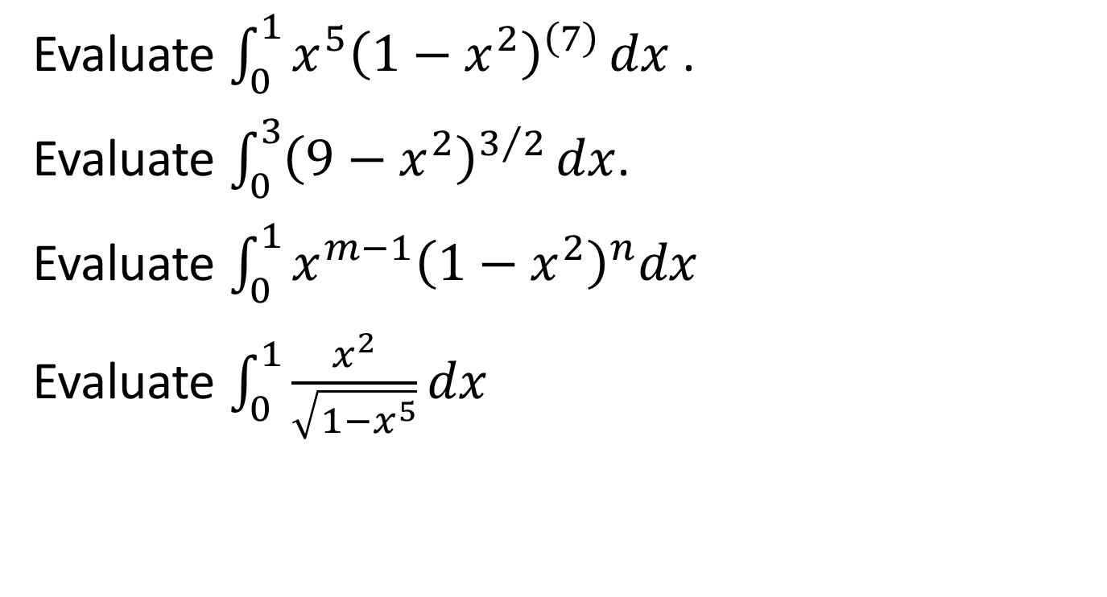
Problem-6
Evaluate $\int_{0}^{1}{x^{5}{\left(1−x^{2}\right)}^{\left(7\right)}}dx$.
Evaluate $\int_{0}^{3}{{\left(9−x^{2}\right)}^{3/2}}dx$.
Evaluate $\int_{0}^{1}{x^{m−1}{\left(1−x^{2}\right)}^{n}dx}$
Evaluate $\int_{0}^{1}{\frac{x^{2}}{\sqrt{1−x^{5}}}dx}$

Slide 17
Solution
1.integrate(x^(5)*(1-x^2)^(7),x,0,1);
makegamma(%);
2. integrate((9-x^2)^(3/2),x,0,3);
makegamma(%);
3. integrate(x^(m-1)*(1-x^2)^(n),x,0,1);
makegamma(%);
4. integrate(x^(2)/sqrt(1-x^5),x,0,1);
makegamma(%);

Slide 18
Output
1. 1/720
(%o7) 1/720
2. (243*%pi)/16
(%o8) (243*%pi)/16
3. "Is "m" positive, negative or zero?"positive;
"Is "n+1" positive, negative or zero?"positive;
(%o14) beta(m/2,n+1)/2
(%o15) (gamma(m/2)*gamma(n+1))/(2*gamma(n+m/2+1))
4. beta(1/2,3/5)/5
(%o19) (2*sqrt(%pi)*gamma(3/5))/gamma(1/10).

Slide 19

Problem-7
Find the following:
a)j(1/2,x);
b)j(3/2,x);
c)j(-1/2,x);
d)Find ${\text{j}\text{(1/2,}\text{x}\text{)}}^{2}+{\text{j}\text{(−1/2,}\text{x})}^{2}$

Slide 20
Solution
besselexpand:true$
a:bessel_j(1/2,x);
bessel_j(3/2,x);
b:bessel_j(-1/2,x);
a^2+b^2;
trigsimp(%);

Slide 21
Output
(sqrt(2)*sin(x))/(sqrt(%pi)*sqrt(x))
(%o10) (sqrt(2)*sqrt(x)*(sin(x)/x^2-cos(x)/x))/sqrt(%pi)
(b)(sqrt(2)*cos(x))/(sqrt(%pi)*sqrt(x))
(%o12) (2*sin(x)^2)/(%pi*x)+(2*cos(x)^2)/(%pi*x)
(%o13) 2/(%pi*x)

